Slide 1

BC2410, Prescriptive Analytics From Data to Decisions
A Brief Review of Lecture 12

Slide 2
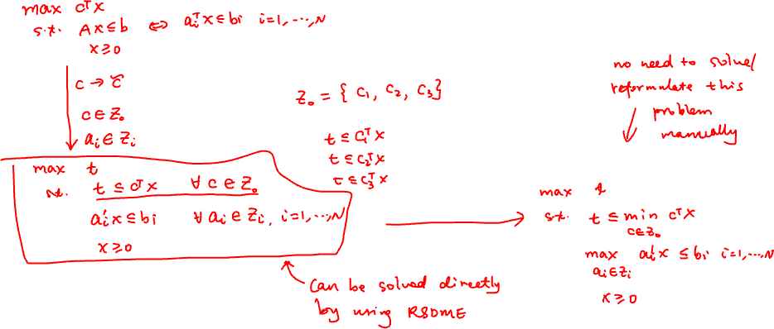
Robust Optimization

Slide 3
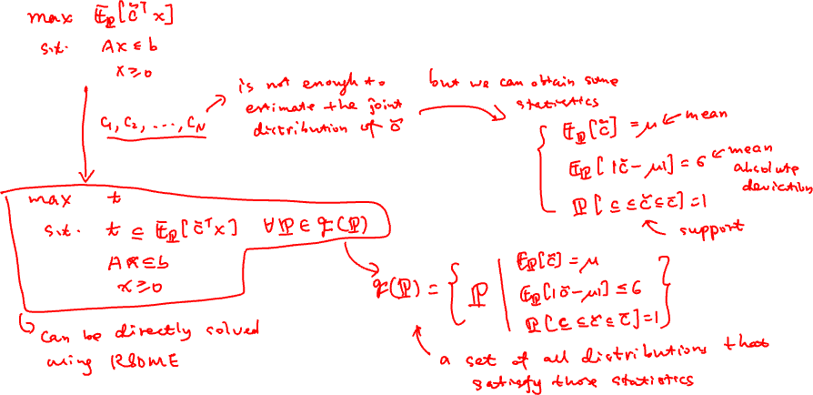
Distributionally Robust Optimization

Slide 4
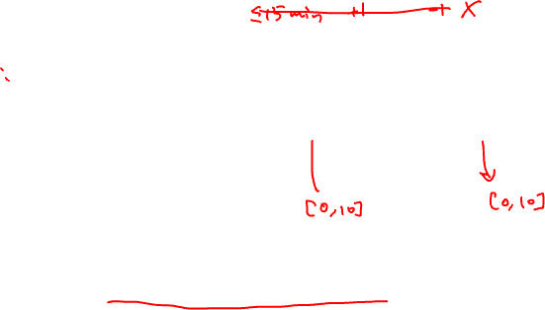
On Group Project Presentation
Each group has 20 mins (15 min presentation + 5 min Q & A)
Presentation accounts for 10 marks for each of you
Assessed by your classmates (40%) and me (60%)
Each group submits the grades before the end of the class
Download Sitting Plan
Fill in your evaluations
Decide final grades
Submit the file to NTULearn “Assignments->Group Project Presentation Evaluation”

Slide 5
On Group Project
Report – At most 10 pages
Introduction
Model formulation
Analysis of solutions
Code in Jupyter Notebook
Model should be generic
Data must be read from a file or directly import from an online database
Submission
Compress all the files as one file
Submit it to NTULearn: “Assignments->Group Project Report and Code”
Due for report submission: 17 April

Slide 6
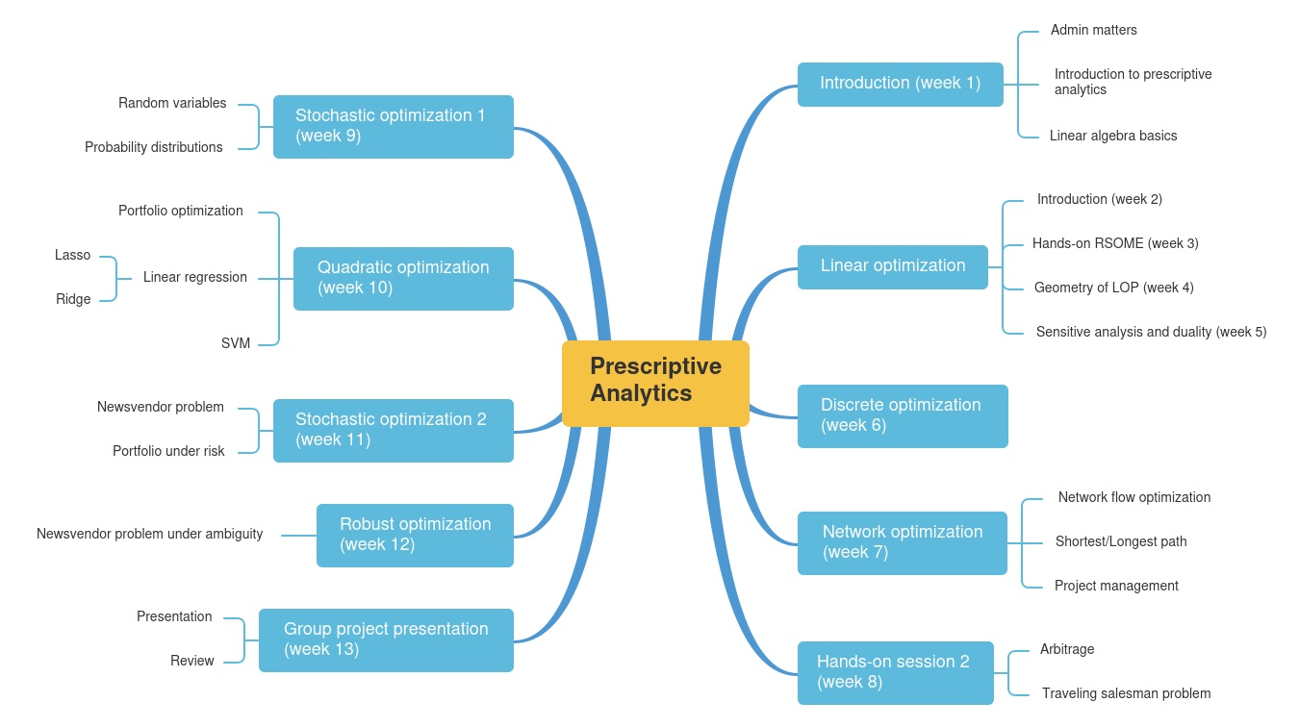
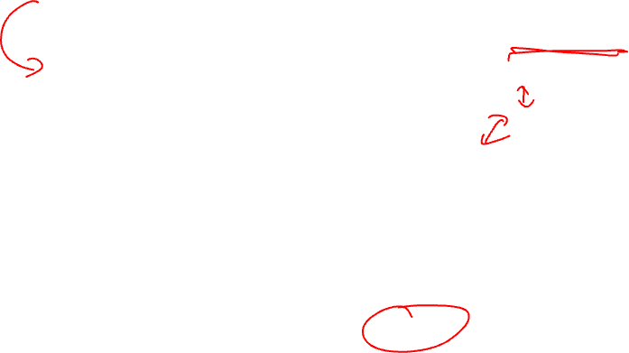

Slide 7
